Slide 1
UPPMS
University Programming Project Management System
Students
Baraa Abdullah
Sohayb Sabboura
Obada Kahwajy
Supervised by
Anas Abdulaziz
Seminar 2 Presentation · Syrian Private University

Slide 2
1. Problem Statement
• Graduation projects are managed with scattered tools (chat, sheets, email).
• No reliable isolation when multiple universities share one platform.
• Choosing a project idea and breaking it into tasks is slow and unstructured.
• Defense scheduling is manual, conflict-prone, and hard to optimize.
• Supervisors and admins lack a single source of truth for proposals, progress, and defenses.

Slide 3
2. How Our System Solves the Problem
Secure Access
Multi-tenant isolation by university
XML-based authorized registration
Role-based access (RBAC)
Smart Project Flow
AI project ideation (Gemini)
Supervisor proposal approval
AI task breakdown + GitHub link
Academic Control
Configurable academic tracks
Defense result updates progress
Intelligent Defense Scheduling
Genetic algorithm generates conflict-aware schedules Rooms, availability, committees, and constraints
Admin reviews candidates and approves the final plan
One Platform
Students, supervisors, university & platform admins
Projects, tasks, notifications, dashboards together.

Slide 4
4. Implemented Before vs Now
Previously Implemented
• Core projects, tasks, comments
• Invitations & GitHub linking
• Notifications & dashboards
Implemented Now (Recent Phases)
• Scheduling infrastructure (rooms, availability, stages)
• Genetic Algorithm scheduling engine
• XML registration & data matching
• Project proposals & supervisor approval
• Academic tracks & sequential progress

Slide 5
5. Methodology
Agile Scrum
Sprints
Sprint Planning
Work split into 3 deliverable and reviewable sprint cycles.
Each phase converted to tasks in tasks.md with clear dependencies.
Spec-Driven Dev
Incremental Delivery
Specification-driven development using Spec Kit.
Each sprint ships an independently testable feature.
Continuous Testing
PHPUnit and feature tests after every sprint.

Slide 6
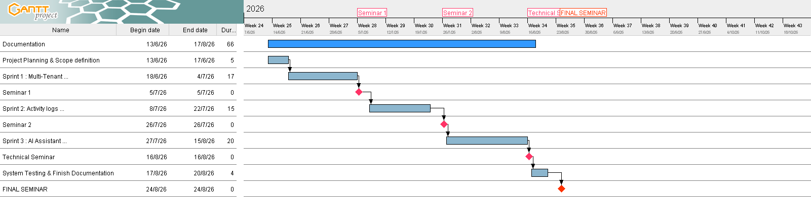
5.1 Gantt Chart

Slide 7
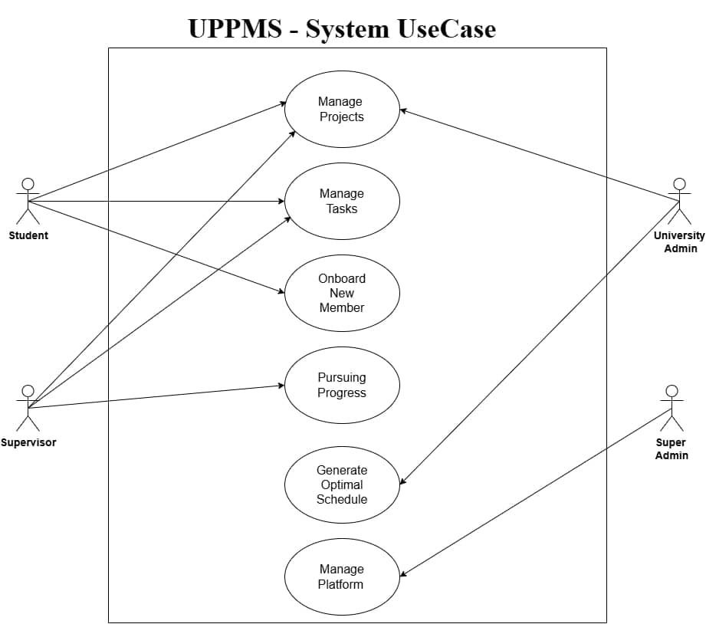
5.2 Use Case Diagram

Slide 8
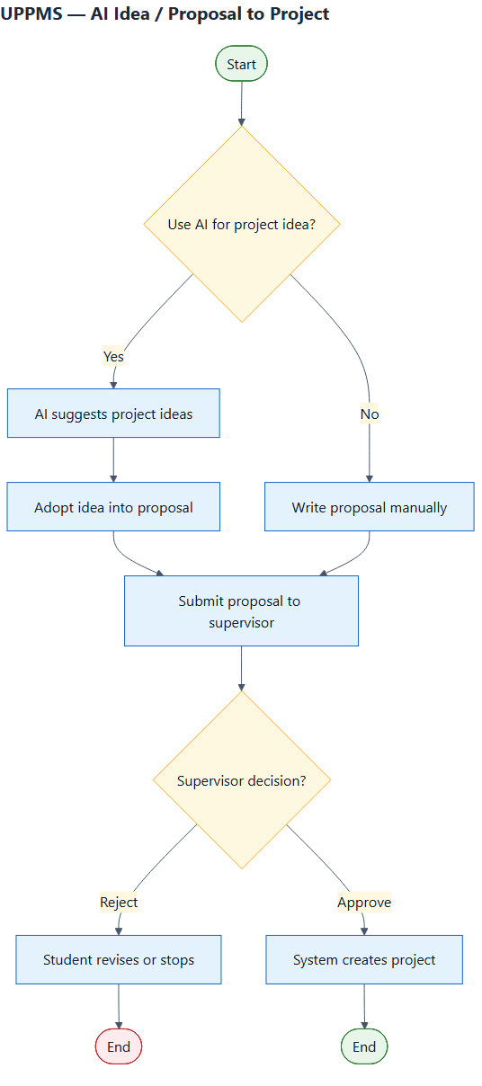
5.3 Activity Diagram

Slide 9
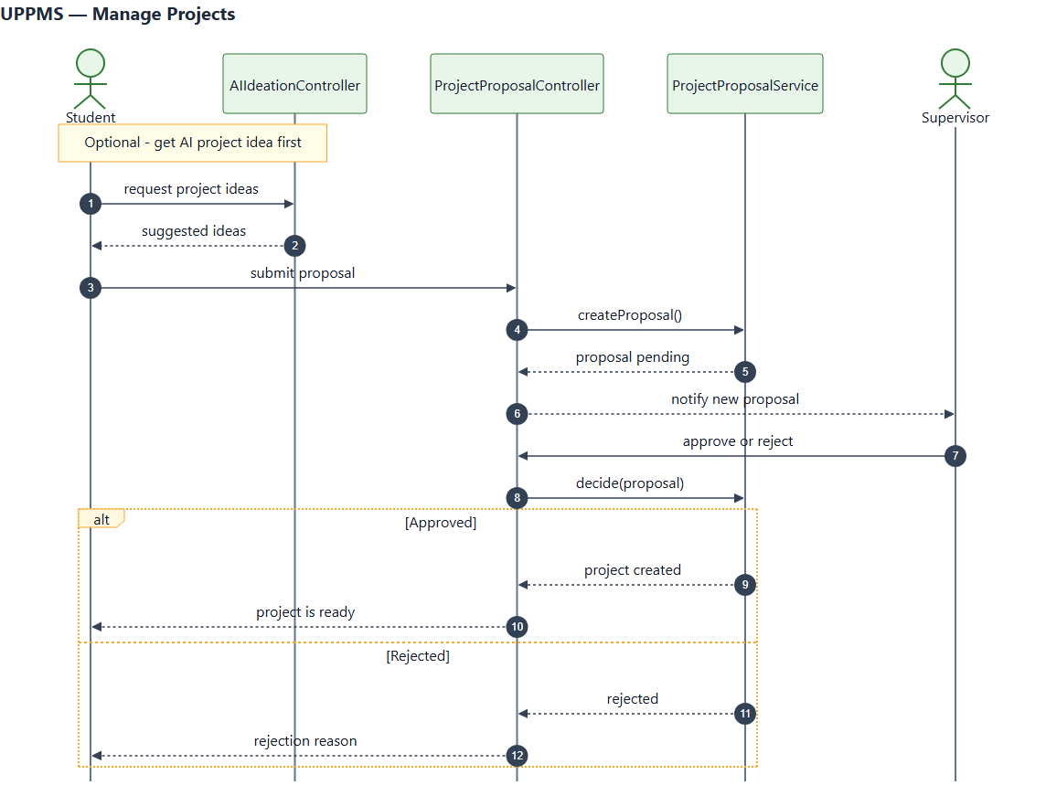
5.4 Sequence Diagram

Slide 10
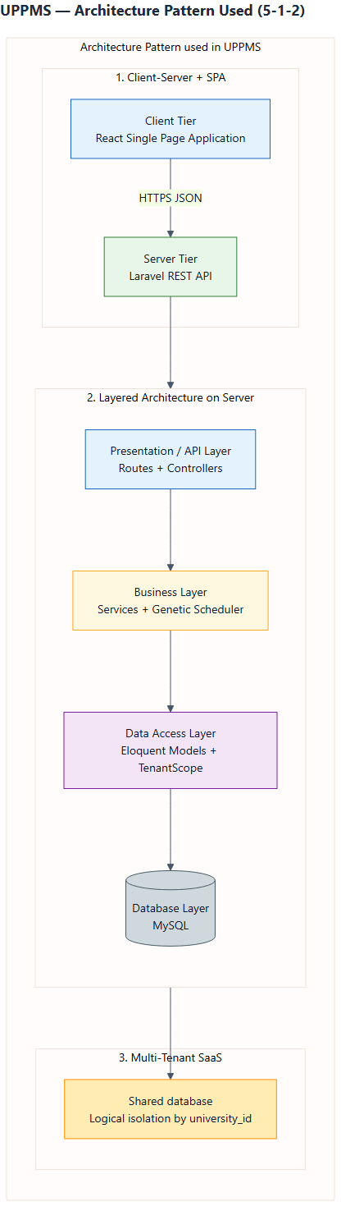
5.5 Architecture Overview

Slide 11
6. Tools Used
Backend
Laravel (PHP)
Eloquent ORM
MySQL
REST API + Sanctum
Frontend
React (Vite)
Material UI
React Router
i18n (EN / AR)
AI & Algorithms
Google Gemini API
Genetic Algorithm
Constraint fitness
Engineering Process
Spec Kit (spec-driven development)
PHPUnit feature/unit tests
Git / GitHub

Slide 12
7. Live Demo

Slide 13
Thank You
Questions & Discussion

